Slide 1
PaperUI
Qiong Liu, Chunyuan Liao
FX Palo Alto Laboratory
Palo Alto, California, U.S.A.

Slide 2
Why Paper Related Research
Paper is one of the most widely used communication media and will continue to be used in our daily life for a very long time
  Paper is an essential part of our daily life
  Paper production provides a cost efficient way to use wood mill wastes
  Paper can be recycled or decomposed much easier than most plastics or electronic-devices
  The world produces approximately 300 million tons of paper each year
  Every US office employee generates approximately 9,999 more paper sheets each year
  Many e-products finally stimulate paper usage and create more e-wastes and plastic wastes beyond paper in the past 40 years

Slide 3
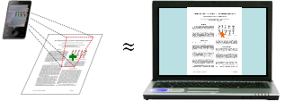
PaperUI Concept
PaperUI is a human-information interface concept that advocates using paper as displays and using mobile devices, such as camera phones or camera pens, as traditional computer-mice.

Slide 4
Why PaperUI
To make more efficient use of paper products as well as novel electronic devices, new technologies are demanded to combine the merits of both paper and electronic devices. PaperUI is an initial attempt to address this issue.
Compared with traditional laptops and tablet PCs, devices involved in the PaperUI system are more light-weight, readable, compact, energy efficient, and widely adopted. Therefore, we believe this interface vision can make computation more convenient to access for general public.

Slide 5
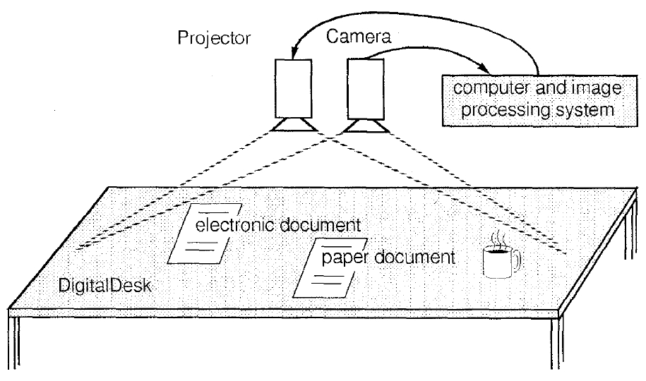
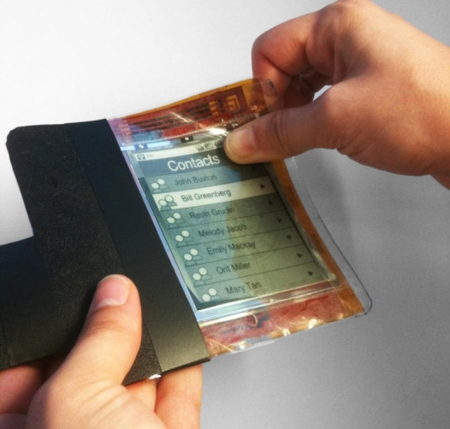
PaperUI Overview
PaperUI can be situated in the design space of interactive paper systems.
PaperUI concept offers more considerations to system mobility, interaction resolution, and energy efficiency.
Different from interactive paper computer.
Excerpt from Wellner UIST ‘91
Excerpt from Science Daily 2010

Slide 6
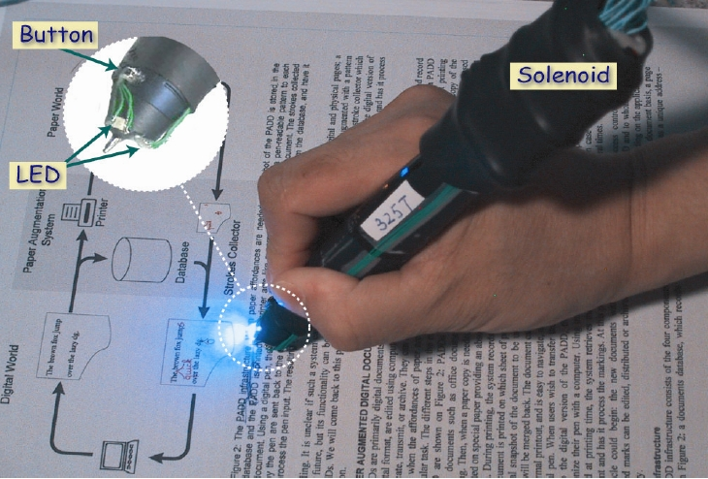
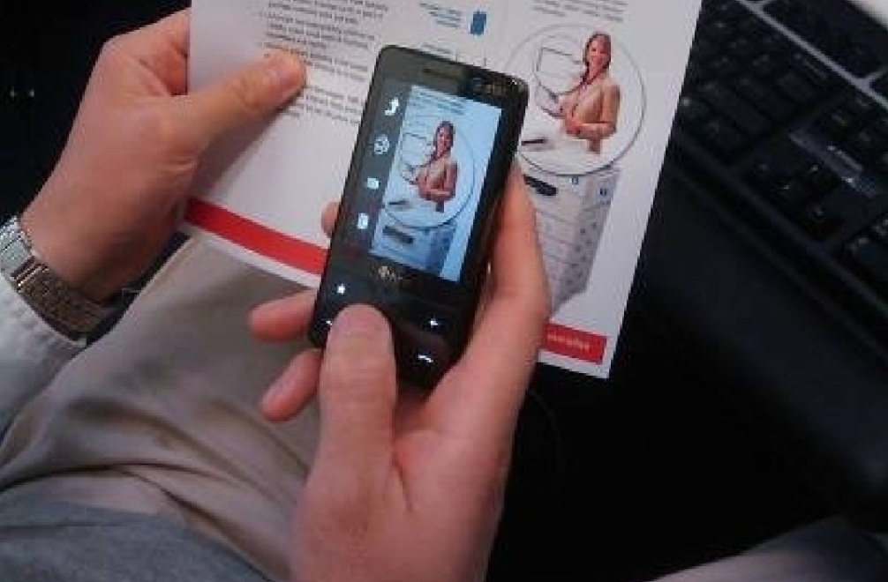
Different Portable Devices for PaperUI
Anoto Pen already has commercial applications
Users need an special device
Visual feedback is limited
Smart phones are widely adopted
Smartphone-based interface has an extra display for visual feedback

Slide 7
Emerging Technologies for Realizing the PaperUI Concept
Barcode
Micro optical patterns
Encoded Hidden Information
Paper Fingerprint
Character/Word Recognition
Local Image Features
RFID-based Document Recognition

Slide 8
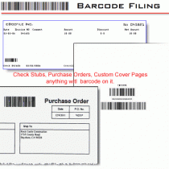
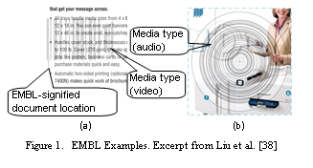
Barcode
Used by most people
Nearly unbeatable robustness and affordance
Not much information for user
Visually obtrusive
  May interfere with the document content layout when multiple links are needed
  May increase paper waste
It is possible to print semi-transparent barcode with meaningful information to users (ICMI 2010 Liu et al.)

Slide 9
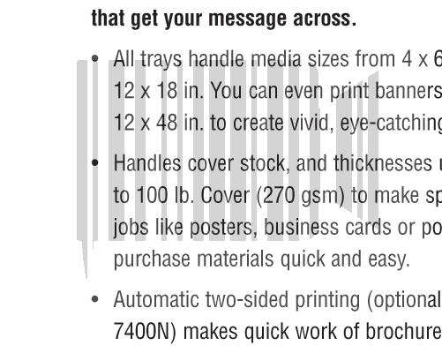
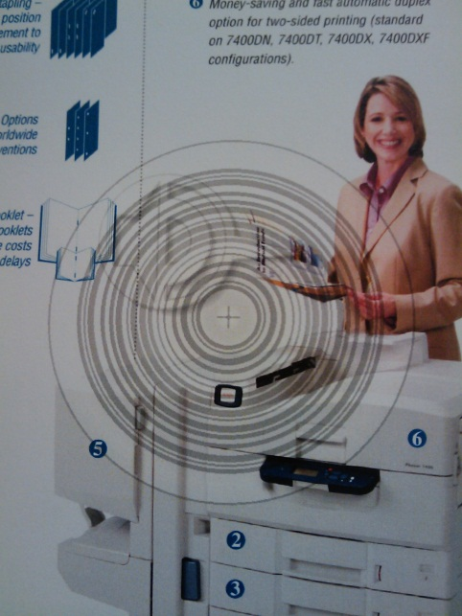
What is EMBL?
  EMBL is a semi-transparent media-icon-modified barcode overlay on paper document content for linking to associated media.
    Use iconic information to reveal media information to human
    Use semi-transparent form to reduce interference to content and move closer to EMBL signified location
    Use semi-transparent barcode to identify document patches
    Barcode can be horizontal, diagonal, vertical, or circular
Media type (audio)
EMBL-signified document location
Media type (video)

Slide 10
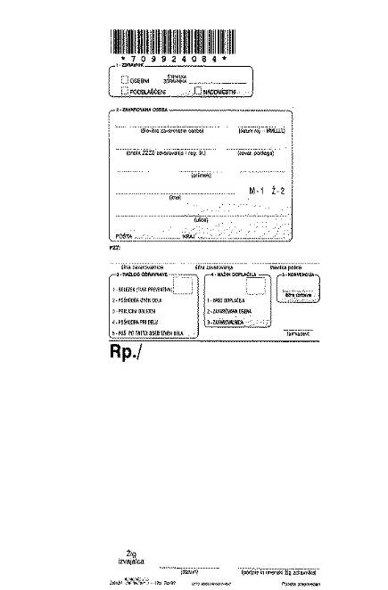

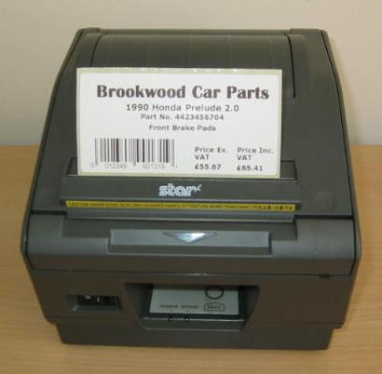
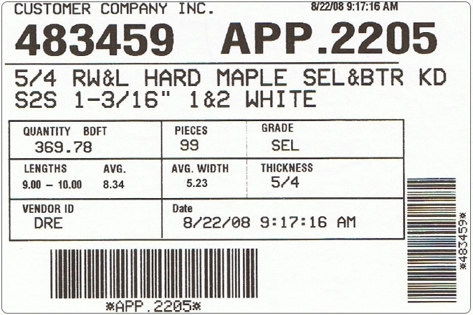
Problem Abstraction for EMBL Authoring
Each document patch may be considered as a communication channel
  Embedded barcode is the signal
  Document contents and iconic marks are noises
  EMBL authoring tool
    Find a proper channel for barcode transmission with proper content-barcode blending
    Select a proper barcode type

Slide 11

EMBL Research
Find the document patch (channel) with lowest noise around a EMBL signified-location for barcode transmission with minimum magnitude (maximum transparency and least interference to document).
  Guidance from the Shannon–Hartley theorem
  Assumption: if the barcode channel’s SNR is over a certain limit, we can get a reasonable barcode identification rate.

Slide 12
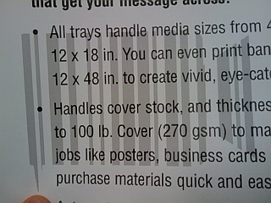
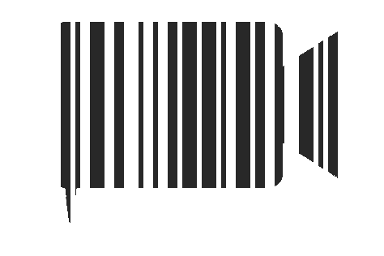
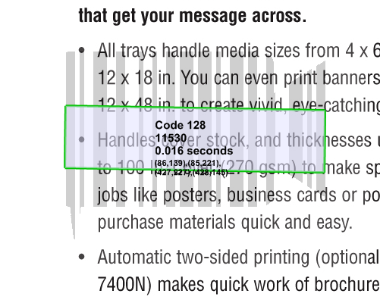
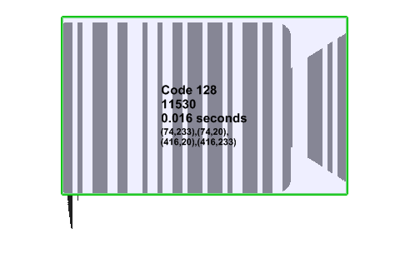
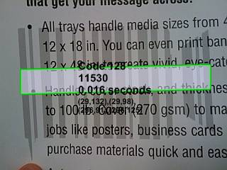
Some Preliminary Experiments – Vertical Barcode

Slide 13

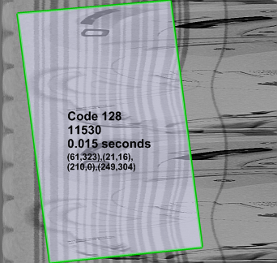
Some Preliminary Experiments – Circular code
Angle
Radius
If the center is not located accurately, we will get many curves instead of straight lines. We can submit multiple slices of the transformed image.

Slide 14
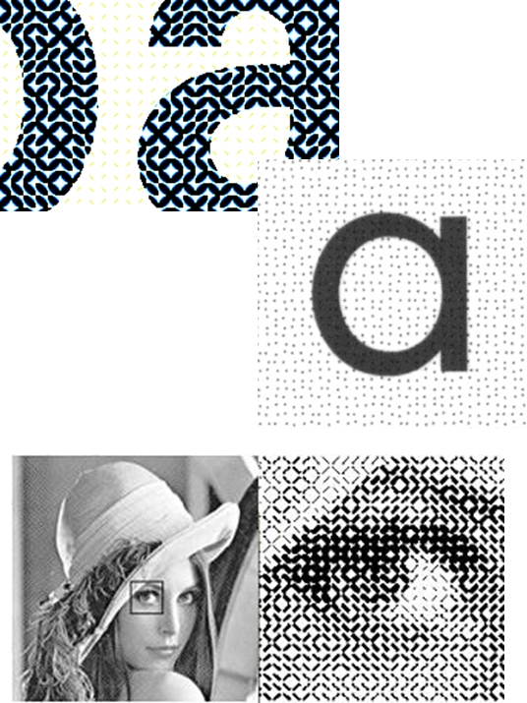
Micro Optical Patterns
Dataglyph and Anoto dot pattern
Identification accuracy is high
Much smaller in size
  Dataglyph – 1/100”
  Anoto dot grid – 0.3mm
Less intrusive than traditional barcodes and better localization
High-res (600-1000dpi) printer & camera
Hard to use camera phone for pattern capture
Reduce image contrast

Slide 15
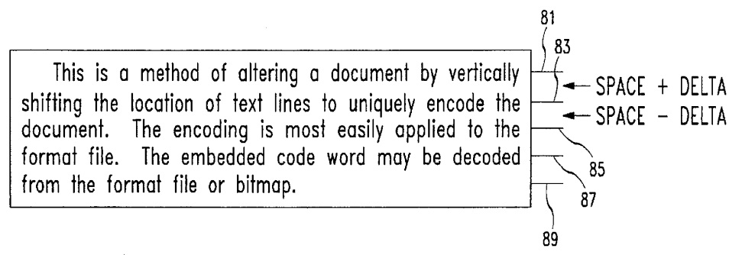
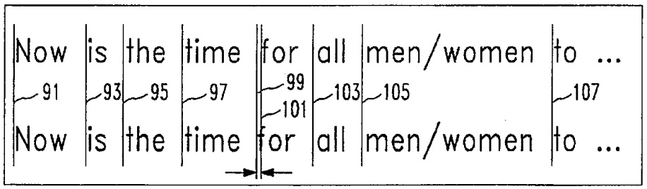
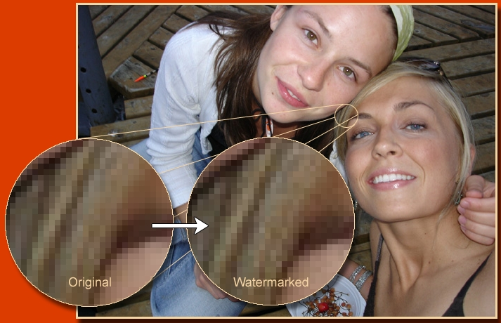
Encoded Hidden Information
Shift line upwards or downwards by very small amount
Shift words horizontally to modify the spaces between words
Less adaptive to a big variety of document contents
Crosstalk between the watermark signal and host signal is a common problem

Slide 16
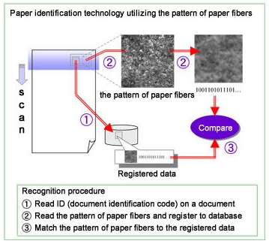
Paper Fingerprint
Paper is composed of fine fibers entangled with each other.
  Very durable
  Have very low probability to be identical
Wood fibers are normally much smaller than basic units of micro-optical-patterns
No error correction

Slide 17
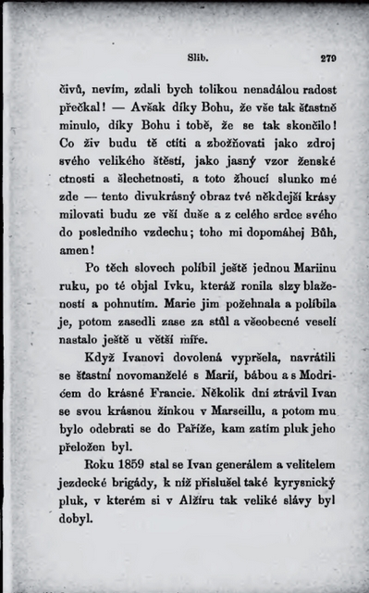
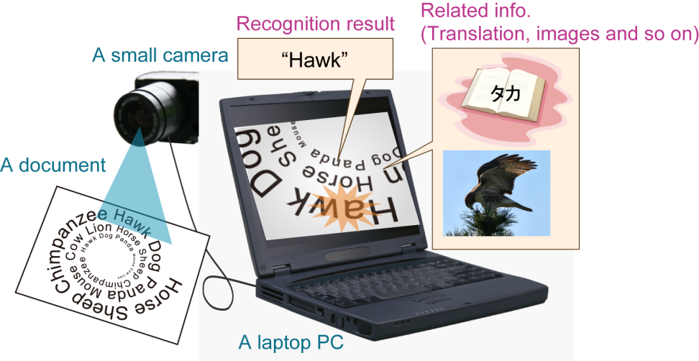
Character/Word Recognition
Commercial OCR software is widely used to convert printed books and documents into text for web publication, text-to-speech, text-mining etc.
Development is much easier with existing module
Language dependent
Requires high resolution cameras for image capture
Most OCR software cannot handle angled document capture, or low lighting capture
Cannot work on photos or figures
Layout free and language independent character recognition is a promising direction

Slide 18
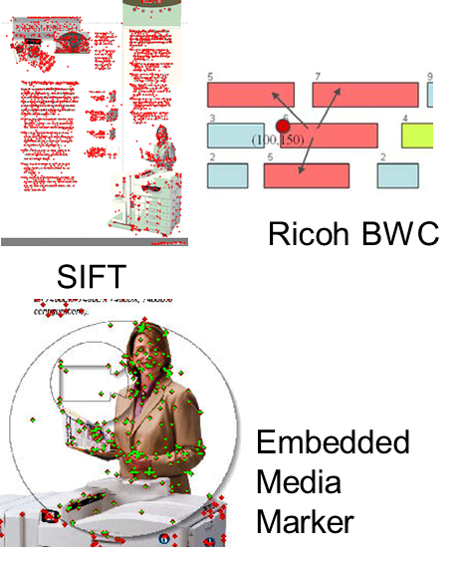
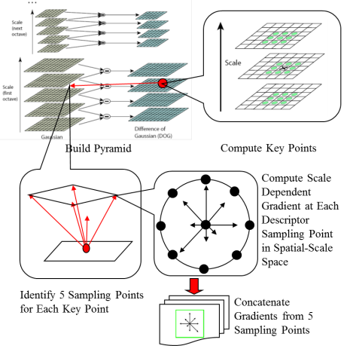
Local Image Features
Spatial layout based feature.
Pixel level image features
No exclusive space demand for marker printing
No demand for changing printing procedure
Most of them can work on cameraphone images
Assist us to accurately locate crosshair so that the crosshair can be used as a mouse pointer

Slide 19
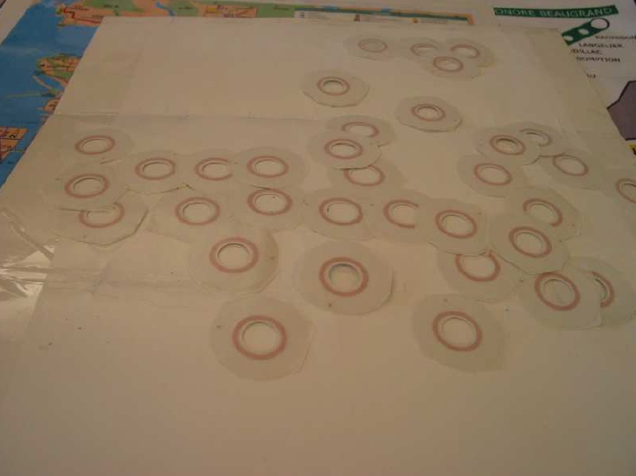
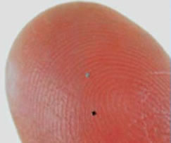
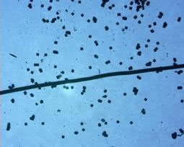
RFID-based Document Recognition
RFID chips are small enough to be embedded in sheets of paper
Allow users to interact with paper at a distance
Fast response speed
Special printer need to be developed for accurately “printing” these RFID devices on paper
More portable RFID identification devices
Technology that can avoid RFID interferences from other pages
Identify the user selected RFID from proximate RFIDs
How to estimate pointing direction?

Slide 20
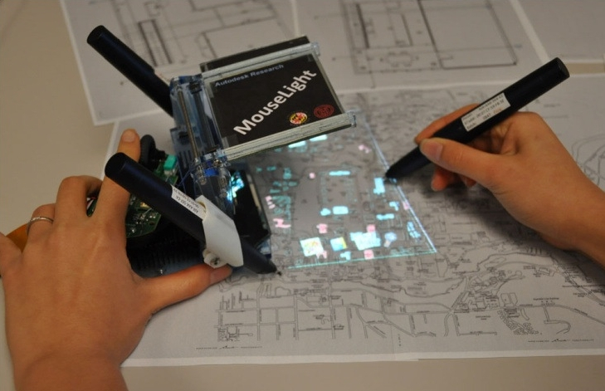
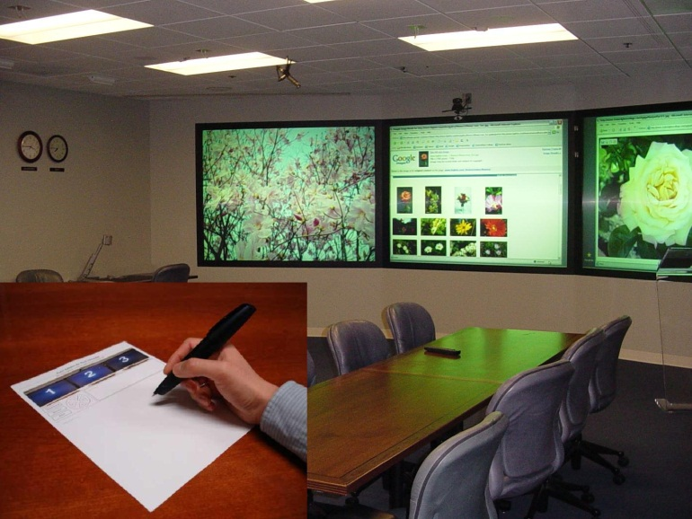
Digital Pen Based Applications
Form filling
Convert notes to text and upload documents
Sync note taking and audio recording, photo capture, GPS
Music, calculator, language study
Retrieve additional info, copy-paste, section view, 3D model navigation
Device control
…

Slide 21
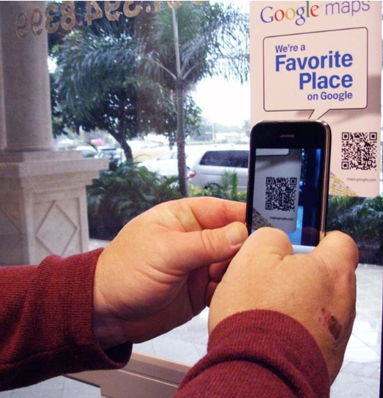
Barcode Based Applications
Compare product price
Read reviews
Acquire coupons
Navigate a city guide or map
Get athletes' videos, pictures and fan data from a poster
Read additional contents linked to an IEEE article
Menu selection
…

Slide 22
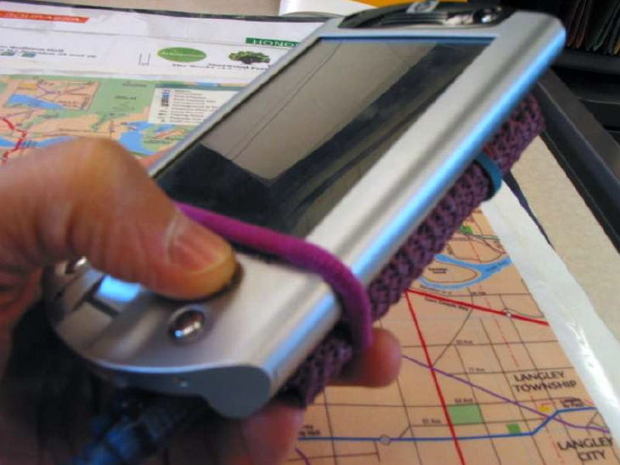
RFID Based Applications
Get digital information of a map region
  Restaurant
  Hotel
  Shopping center
  Accurate transit
  Upcoming shows
  …

Slide 23
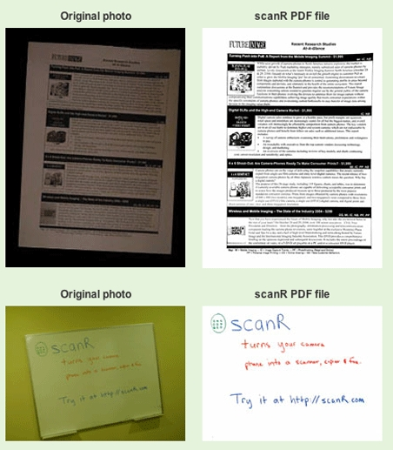
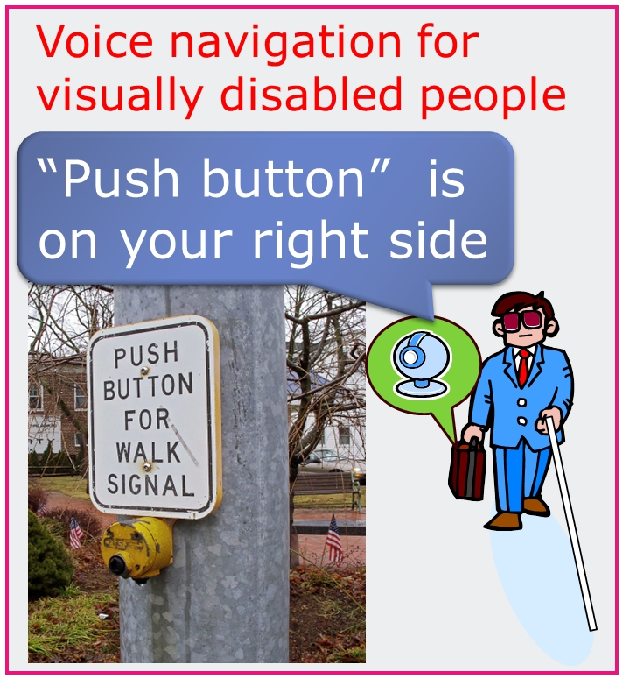
Character/Word Recognition Based Applications
Convert a camera phone image of a hardcopy into PDF for search, editing, email, text to audio translation
Translate the card into digital information and add that information into address book
Translator for foreign restaurant menus, posters

Slide 24
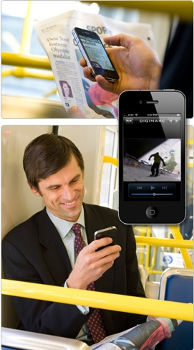
Encoding Hidden Information Based Applications
DigiMarc - invisible
Uses a small visible icon to remind users about the extra data existence
Bring videos, interaction widgets, and other multimedia information to a cameraphone via capturing a DigiMarcTM encoded paper page
Find product coupons, compare product price, and find product stores via capturing a product package

Slide 25
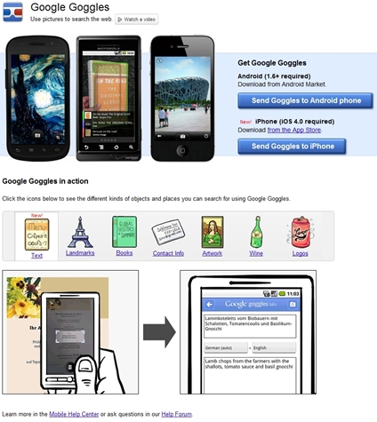
Original Document Feature Based Applications
Book/CD/DVD/Game search
Artwork search
Interactive story telling
Ad capture initiated store navigation
Get remote weather info from map

Slide 26
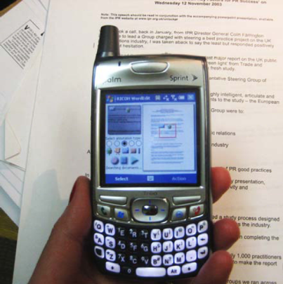
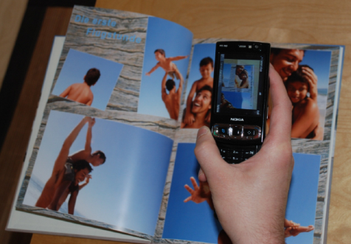
Original Document Feature Based Applications
University of Oldenberg “Bookmarkr”
Link photobook picture to digital photo.
Use SIFT features
ACM Multimedia 08
Ricoh “HotPaper”
Link personal media to text.
Use BWC (Brick Wall Coding)
Only works on Western text
ACM Multimedia 08

Slide 27
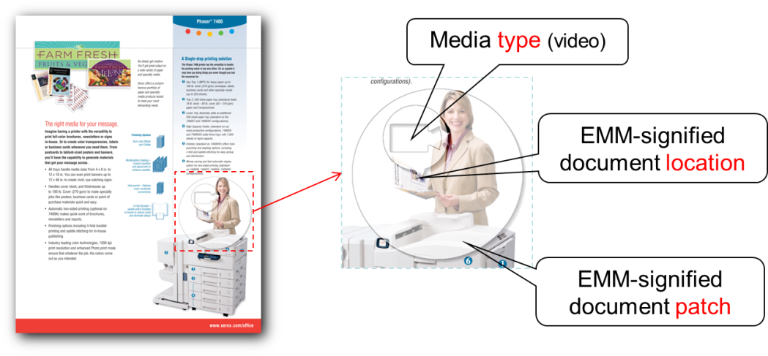
Problems of Using Original Features
Our solution: EMM
Embedded Media Markers (EMM) are optical-filter-like overlaid marks printed on paper documents.
  Provide users multimedia cues and interaction guidance
  Save computation and improve performance
  Minimize the interference with document content
Issues
  Where to capture
  How to capture
  What is available
  What to index
  How to improve recognition with limited resources

Slide 28
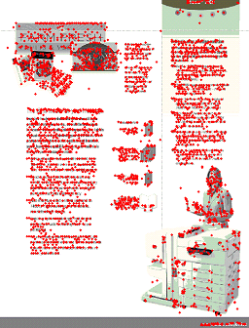
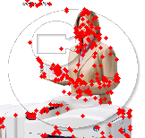
EMM Authoring Tool
  Semi-automatically arrange EMM based on feature distribution
    Criterion 1 – Minimize author’s effort. Author only selects an EMM anchor point.
    Criterion 2 – Minimize machine resources used for patch query. Find a small feature boundary, and index the small number of keypoints inside the feature boundary.
    Criterion 3 – Minimize the EMM interference to document. Minimize the number of keypoints overlaid by an EMM.

Slide 29
Parameter Optimization
EMM boundary optimization
  Find the center (X,Y) and the minimum radius R such that
    The number of keypoints in the circle exceeds the threshold to ensure patch identification accuracy
    The user selected anchor point is contained in the boundary
Media type icon placement
  Select the media-type-icon center (x,y) so that the icon covers the minimum number of keypoints

Slide 30

Parameter Optimization Speedup
  Counting the number of keypoints in a circle is time consuming
    O(2N). N is the number of keypoints in a page.
  Speedup
    Inscribed square to estimate the number of keypoint in a circle
    Use the cumulative feature-point histogram
    I_{ABCD} =I_{C}-I_{B}-I_{D}+I_{A}
  Optimization of media type circle is similar
P
I_{P}
A
B
A
B
D
C
D
C
Boundary Circle

Slide 31
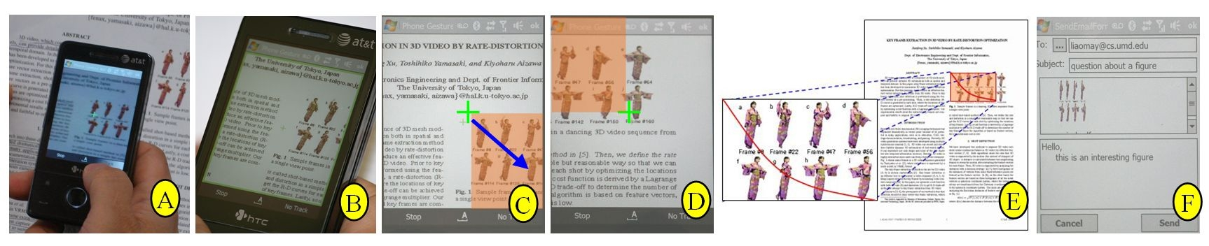
Fine-grained Phone-paper Interactions
PACER [Liao and Liu] features a camera-touch hybrid interface. It allows users to manipulate fine-grained document content with various gestures beyond point-and-click.
Introduction, Hybrid Gesture, Application, Remote Collaboration.

Slide 32
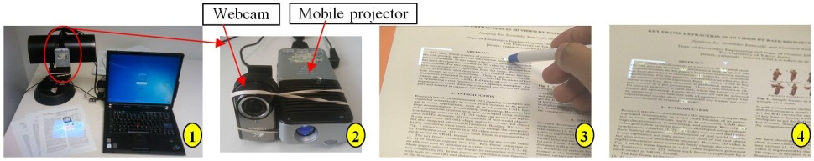
FACT: Fine-grained Cross-media Interaction
Different from the PACER usage scenario, a user may also want a portable system support for reading with papers on a desk. Less mobile but more comfortable.
FACT [Liao et al.] allows a user drag a picture on a paper page to a nearby laptop with a finger on paper or type text via the laptop keyboard to annotate an illustration in a printout.
Introduction, Application.

Slide 33
MixPad
The PaperUI interface can be used with existing computer interfaces to take both advantages. .
MixPad [Liao and Liu] allows a user to issue pen gestures on the paper document for selecting fine-grained content and applying various digital functions a traditional computer can issue.
MixPad.

Slide 34
Thank You

Slide 35
Bio
Qiong Liu is a senior research scientist at FX (Fuji-Xerox) Palo Alto Laboratory. He has authored and co-authored more than 50 papers and holds more than 40 issued and pending patents in the fields of PaperUI, object/document recognition, IR-camera based vital sign detection, immersive conferencing, signal processing, human-computer interaction, and robotics. His papers were nominated for best paper award 3 times and won best paper award once in ACM conferences. He has a Ph.D. in computer science from the University of Illinois at Urbana-Champaign. He’s a member of the ACM and a senior member of the IEEE.

