Slide 1
Real-Time Camera-Based Character Recognition Free from Layout Constraints
M. Iwamura, T. Tsuji, A. Horimatsu, and K. Kise

Slide 2
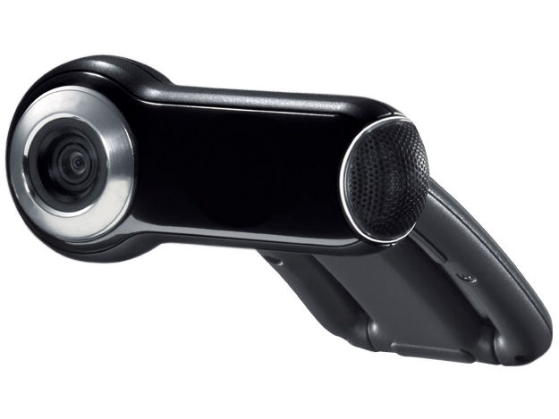
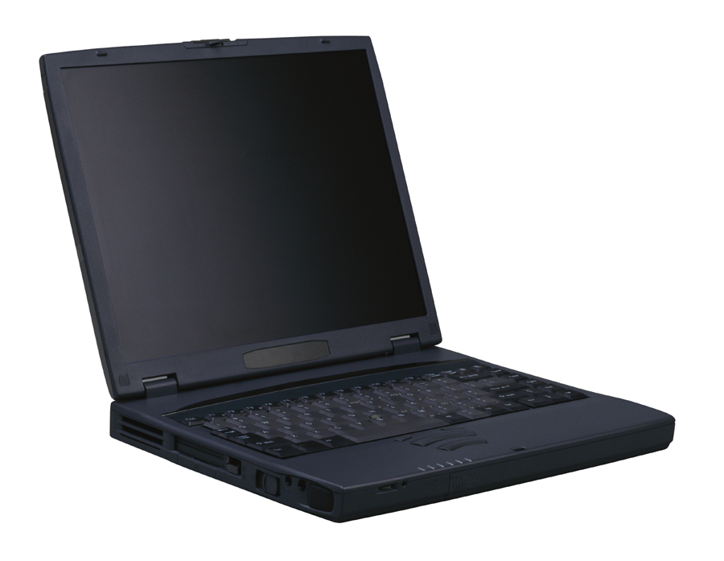


Real-Time Camera-Based Character Recognition System
Recognizes ~200 characters/sec
Recognizes characters immediately!
Web camera
IMP
Capture
Document
Notes:
In this presentation, we would like to introduce a Real-Time Camera-Based Character Recognition System.

Slide 3
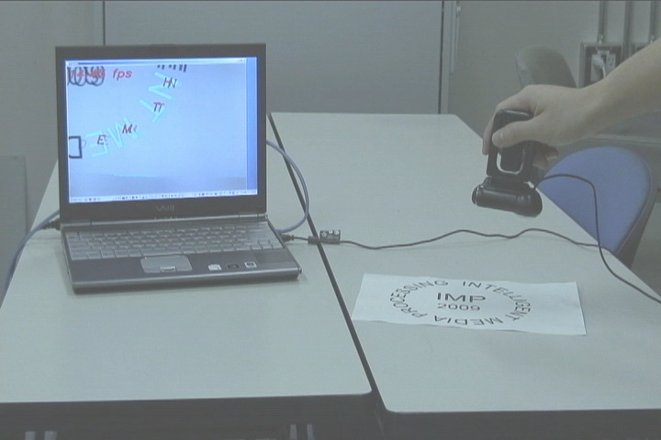
DEMO

Slide 4
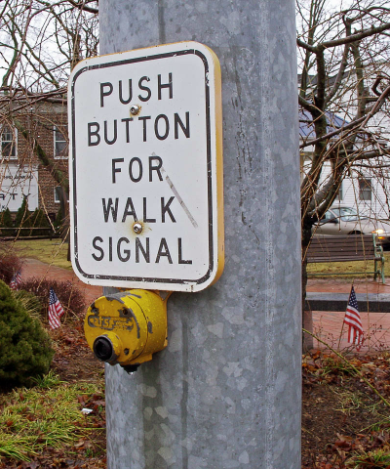


Applications
Recognizes all characters in a scene and provide useful information only
Voice navigation for
visually disabled people
Translation service for
foreign travelers
“Push button” is on your right side
Car-free mall
♪
♪
Notes:
The possible applications include a voice navigation system for visually disabled people and a translation service for foreign travelers.
For the first one, a visually disabled person cannot see the scene around him. So, a way to help him is to capture the scene all around him and recognize all characters included in the captured image. And, it provides useful information that he registered in advance.
And the second one is the translation service. I guess you can imagine this application. The idea is proposed a decade ago. But, no one has realized it.

Slide 5
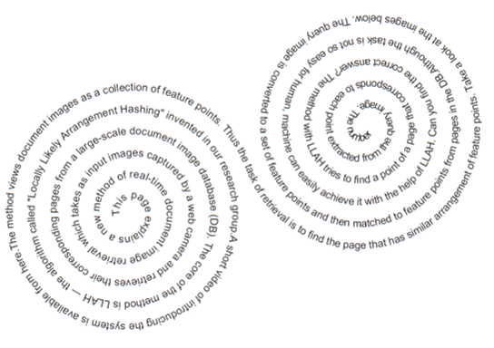
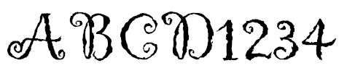



3 Advantages of the
Proposed Method
First method that realizes three requirements
1: Real-time
・Recognizes ~200 characters/sec
3: Layout free
2: Robust to perspective distortion
・Recognition accuracy is >80% in 45 deg.
Recognizes designed characters and pictograms

Slide 6
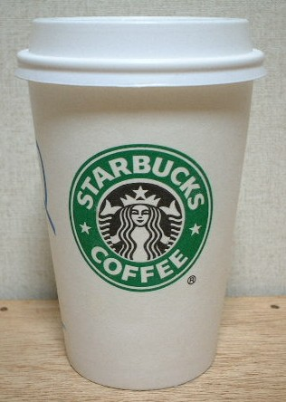
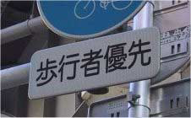


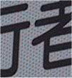
Existing Methods and Problems
Real-time recognition capable only for characters in a straight text line
Can recognize each character in a complex layout with much computational time
Recognizable
Not recognizable

Slide 7
Existing Methods vs Proposed Method
2: Perspective distortion
1: Real-time
3: Layout free
Myers 2004
Kusachi 2004
Li 2008
Proposed method
Recognition of Individual Characters
Real-time Processing
Notes:
7
Our proposed method recognizes each deformed character, too.
But it also realize the real-time processing.
That is, our proposed method satisfies all of 3 requirements.

Slide 8
Contents
Background
Overview of the Proposed Method
Contour Version of Geometric Hashing
Proposed Method
  Real-Time Processing
  Recognition of Separated Characters
  Pose Estimation
Experiment
Conclusion

Slide 9

Overview of the
Proposed Method 1
Handled by post processing
i
Recognizes individual connected components
Assumptions
  Black characters are written on a flat white paper
  All connected components are easily segmented
Realizes
3: Layout free
S
c
h
o
o
l
How to quickly match segmented connected components
Notes:
9
In order to be free from layout constraints, our proposed method recognizes each connected component.
In this research, recognition objects are defined as black texts on a flat white paper.
And we assume that we can extract connected components with binarization.

Slide 10


Overview of the Proposed Method 2
Affine invariant recognition
  Three corresponding points help matching
Realizes robust recognition
to
2: Perspective distortion
Normalization
Input Image
Match
A
Normalization
Reference Image
Notes:
10
For robustness to perspective distortion, our method does affine invariant matching.
If corresponding 3 feature points are extracted, the captured image and the template image can be matched by normalization.
There is a method to cope with the problem which is called geometric hashing, in short, we call GH.
We apply GH to recognition of a connected component, and we call the method contour version of GH.
The method is the base of our proposed method.

Slide 11
Overview of the Proposed Method 2: Contour Version of Geometric Hashing
Existing method：
Geometric Hashing (GH)
Contour Version of GH
Start point of the proposed method
A
Applied GH to recognition of CCs
No. of Points：P
Matching of point arrangement
Matching of Shape
Notes:
11
Firstly, feature points are extracted from P outer contour pixels.
And the 3 points are chosen from them.

Slide 12

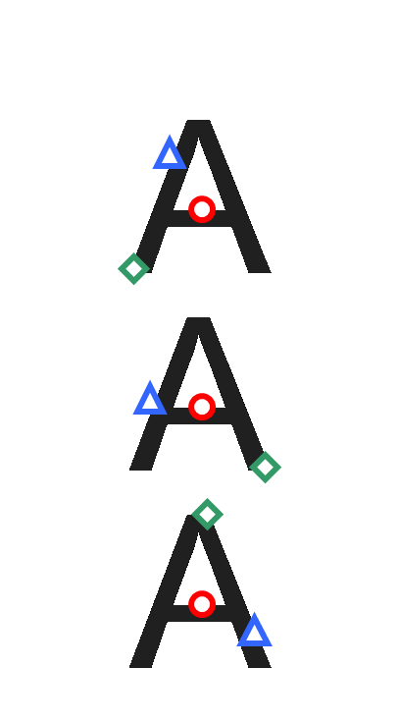
Overview of the Proposed Method 3:
Three-Point Arrangements of CVGH
CVGH examines all three points out of P points
1st
2nd
3rd
Database
No. of Patterns
P
×
(P-1)
×
(P-2)
=
O(P³)
Notes:
12
In this method, 3 points are selected randomly from P contour points.
For matching the images, all arrangements have to be generated.
The total number of the patterns is the order of P cubic.
This is too large number to compute the feature vector in real-time.

Slide 13
Overview of the Proposed Method 3:
Three-Point Arrangements of Prop. Method
Proposed method snips useless three-point arrangements
In case of P=100
1st
CVGH
2nd
3rd
Database
970,200
Proposed Method
100
Realizes
1: Real-time
O(P³)
No. of Patterns
1
×
P
×
1
=
O(P)
Notes:
13
In order to recognize a character in real-time, we reduce the 3-point arrangements without losing its recognition ability.
The key idea of the reduction is to use an affine invariant in a different manner as usual.

Slide 14
Contents
Background
Overview of the Proposed Method
Contour Version of Geometric Hashing
Proposed Method
  Real-Time Processing
  Recognition of Separated Characters
  Pose Estimation
Experiment
Conclusion

Slide 15
Contour Version of GH:
Matching by Feature Vectors
Calculation of feature vector
  Normalize
  Divide into subregions
  Create a histogram of black pixel
  Quantize
4x4 Mesh Feature
A
0
1
2
1
1
2
...
Feature Vector
Notes:
15
In order to match the images, a feature vector is computed.
Firstly, 2 lines are drawn and the image is normalized so that 2 lines are perpendicular.
And the image is divided into several equal parts.
Then, ratios of black area in every subregions are computed.
The value of the ratio is quantized.

Slide 16
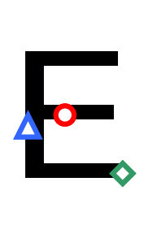






Contour Version of GH:
Storage
Feature vectors are stored in the hash table
A
0
Hash ID : 1
A
1
2
Hash table
Hash ID : 5
3
A
4
5
Hash ID : 2
6
…
Notes:
16
In the storage phase, all the feature vectors are stored with classes and 3 points to a hash table.

Slide 17
Contour Version of GH:
Recognition
Calculate feature vectors
Cast votes
0
1
2
Hash table
ID : 1
ID : 5
ID : 2
3
4
5
Result
6
A
A B ...
R ...
…
Notes:
17
In the retrieval phase, the feature vectors of captured images are computed.
And the corresponding data to the feature vectors is retrieved from the hash table, and then casts a vote for corresponding classes.

Slide 18
Contents
Background
Overview of the Proposed Method
Contour Version of Geometric Hashing
Proposed Method
  Real-Time Processing
  Recognition of Separated Characters
  Pose Estimation
Experiment
Conclusion

Slide 19
  Proposed Method 1:
  Real-Time Processing by Affine Invariant
Usual usage
Area ratio
  Three-point arrangement ➔ Area ratio
A
S₁
Affine Invariant
S’₁
Area Ratio
S₁
S₀
S’₁
S’₀
S₀
=
S’₀
Notes:
19
We use an area ratio which is one of the affine invariants for the reduction.
The usual process is that area ratios S0 and S1 are unchanged before and after affine transformation.

Slide 20
Proposed Method 1:
Real-Time Processing by Affine Invariant
Unusual usage
Area ratio
  Two-point arrangement + Area ratio ➔ Third point
A
S₁
Affine Invariant
S’₁
Area Ratio
S₁
S₀
S’₁
S’₀
S₀
=
S’₀
Notes:
20
The unusual process is that when two points and area ratio are given, the third point can be determined uniquely.

Slide 21
Proposed Method 1:
How to Select Three Points
1st point: Centroid (Affine Invariant)
2nd point: Arbitrary point out of P points
3rd point: Determined by the area ratio
A
Uniquely Determined
No. of Points：P
Notes:
21
Using such a method, we generate the 3-point arrangements as follows.
The first point is determined from the centroid of the connected components instead of a contour point.
In fact, the centroid is affine invariant.
The second point is selected arbitrary from the feature points.
At the selection of the third point the unusual process of the affine invariant is used.
The third point is determined from a point which makes the largest triangle.

Slide 22
Contents
Background
Overview of the Proposed Method
Contour Version of Geometric Hashing
Proposed Method
  Real-Time Processing
  Recognition of Separated Characters
  Pose Estimation
Experiment
Conclusion

Slide 23

  Proposed Method 2:
  Recognition of Separated Characters
Create a separated character table for post processing
CC | Char. | Relative Position | Area of CC | Area of corresponding CC
 | i |  | 5 | 25
 | j |  | 5 | 40
 | i |  | 25 | 5
 | j |  | 40 | 5
Area: 5
Stored
Area: 40
Notes:
23
In order to recognize the separated characters, we prepare a table.
In the storage phase, the data of the separated character such as area and position is stored to the table.
And then, each connected component are stored to the hash table separately.

Slide 24
Contents
Background
Overview of the Proposed Method
Contour Version of Geometric Hashing
Proposed Method
  Real-Time Processing of CVGH
  Recognition of Separated Characters
  Pose Estimation
Experiment
Conclusion

Slide 25




Proposed Method 3:
Pose Estimation
Pose of Paper
Pose of Characters
Estimates affine parameters from correspondences of three points
A
Affine Transformation
Parameters
Independent Scaling
Shear
Rotation
Scaling
Notes:
25
We can estimate the pose of papers and pose of characters by calculating affine parameters from corresponding 3 points which are obtained at retrieval process.
The parameter contains independent scaling, shear, rotate, and scaling.
The pose of a paper is estimated from independent scaling and shear.
And the pose of characters is estimated from rotate and scaling.

Slide 26
Contents
Background
Overview of the Proposed Method
Contour Version of Geometric Hashing
Proposed Method
  Real-Time Processing
  Recognition of Separated Characters
  Pose Estimation
Experiment
Conclusion

Slide 27

Experiment:
Recognition Target
３Fonts
236 Chars
Notes:
27
This is a target paper which contains 236 characters on curving lines.

Slide 28
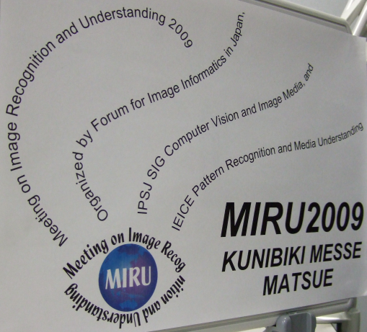
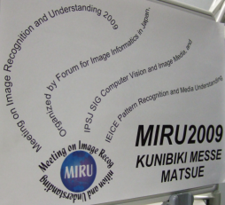
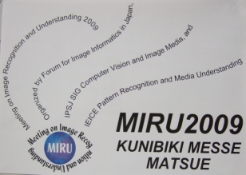
Experiment:
Recognition Target
Captured from three different angles
A server was used
  CPU: AMD Opteron 2.6GHz
Angle： 0 deg.
Angle： 30 deg.
Angle： 45 deg.

Slide 29
Experiment:
Conditions
Some characters are difficult to distinguish under affine distortions
➔ Characters in a cell were treated as the same class
0 O o
6 9
C c
I l
S s
u n
W w
X x
N Z z
p d
q b
7 L V v
Notes:
29
CPU of the server used in this experiment is Opteron 2.6GHz.
We normalized the size of the images.
The long side of the template image was 100 pixels, and that of the captured image was 50pixels.

Slide 30
Experiment:
Recognition Result
Achieved high recognition rates and high speed by changing a control parameter
180-210 characters/sec
Settings | High recognition rates |  |  | High speed
Angle (deg.) | 0 | 30 | 45 | 0 | 30 | 45
Time (ms) | 7990 | 7990 | 7020 | 1300 | 1260 | 1140
Recog. Rate (%) | 94.9 | 90.7 | 86.4 | 86.9 | 81.8 | 76.3
Reject. Rate (%) | 0.4 | 3.0 | 6.4 | 6.4 | 9.3 | 16.5
Error Rate (%) | 4.7 | 6.4 | 7.2 | 6.8 | 8.9 | 7.2

Slide 31
Contents
Background
Overview of the Proposed Method
Contour Version of Geometric Hashing
Proposed Method
  Real-Time Processing
  Recognition of Separated Characters
  Pose Estimation
Experiment
Conclusion

Slide 32
Real-Time Camera-Based Character Recognition System
Recognizes ~200 characters/sec
Recognizes characters immediately!
Web camera
IMP
Capture
Document

Slide 33

Future Work
Recognition of Chinese characters
Improvement of segmentation for
  Broken connected components
  Colored characters
Notes:
33
Future work are to distinguish the similar characters by considering nearby characters on the paper
and to improve the method for extracting objects which are not black texts on a white paper.

Slide 34
Real-Time Camera-Based Recognition of Characters and Pictograms
M. Iwamura, T. Tsuji, A. Horimatsu, and K. Kise

